Slide 1
Tech and AI solutions for conservation
Innovative private finance
Faster
Helping towns and tribes get water infrastructure money
Offset credit and market design and scaling
Outcome contracting & procurement
Effective permitting

Slide 2
Colombia's Habitat Banking Regulation (Resolution 1051
Colombia's Habitat Banking Regulation (Resolution 1051
Biodiversity credit demand
Outcome- focused philanthropic purchasing
Footprint offsetting
Disclosure offsetting
Task Force on Nature-related Financial Disclosures
France Article 29 (companies over 500 employees)
Germany Supply Chain Due Diligence Act
EU Corporate Sustainability Reporting Directive
Regulatory offsetting
US: Clean Water Act
UK: Environment Act
US: Endangered Species Act
EU: Nature Restoration Law
Colombia: Resolution 1051

Slide 3
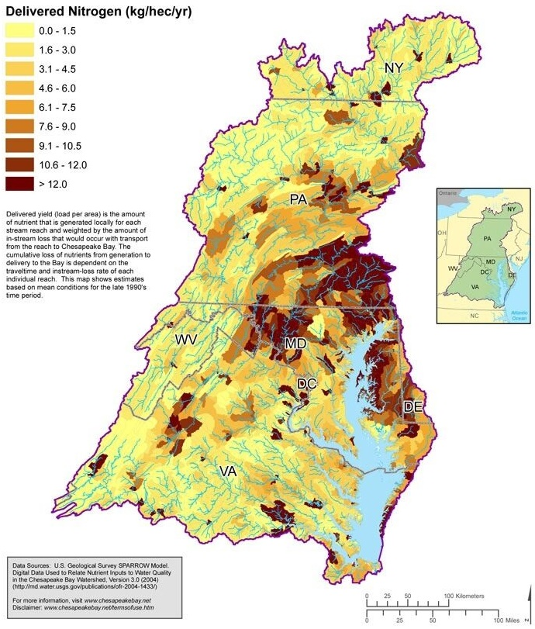
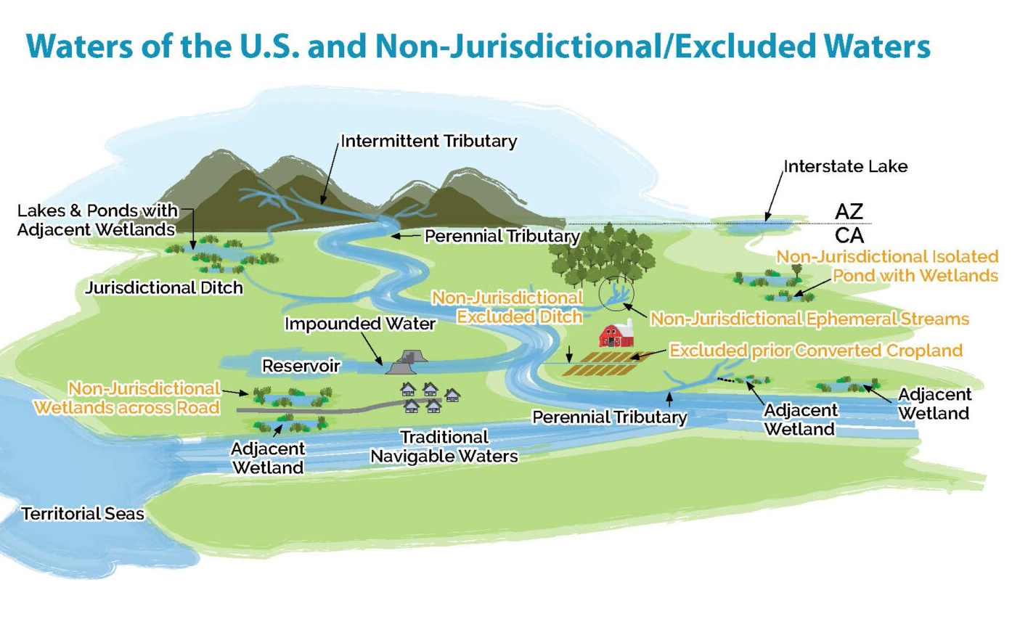
Endangered
species
Wetlands & stream habitats
Water quality
Secure species

Slide 4
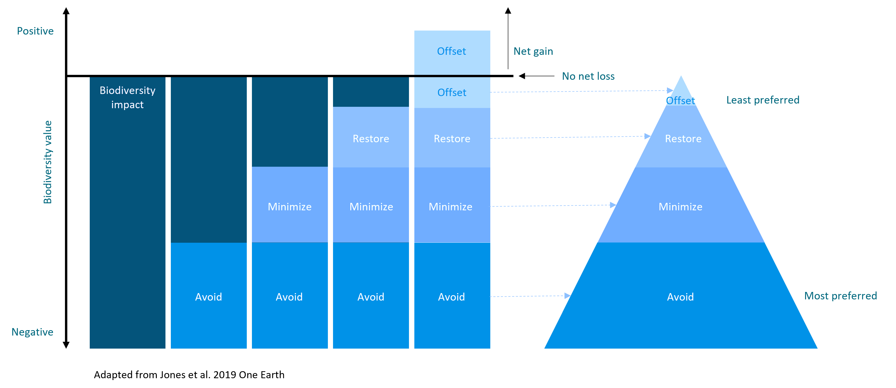

Slide 5
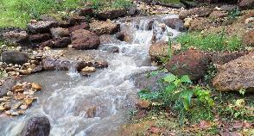

Slide 6
"In our research, we have seen that England and Germany have started to look at models that resemble the American one. However, they are still at a very early stage, so unfortunately there is no real experience to draw on in Europe. So right now it's the United States that you have to look to for inspiration and experience.”
Helle Ærendahl Heldbo, Head of Alternative Investments, AP Pension

Slide 7
Colombia's Habitat Banking Regulation (Resolution 1051
Colombia's Habitat Banking Regulation (Resolution 1051
Biodiversity credit demand
Outcome- focused philanthropic purchasing
Footprint offsetting
Disclosure offsetting
Task Force on Nature-related Financial Disclosures
France Article 29 (companies over 500 employees)
Germany Supply Chain Due Diligence Act
EU Corporate Sustainability Reporting Directive
Regulatory offsetting
US: Clean Water Act
UK: Environment Act
US: Endangered Species Act
EU: Nature Restoration Law
Colombia: Resolution 1051

Slide 8
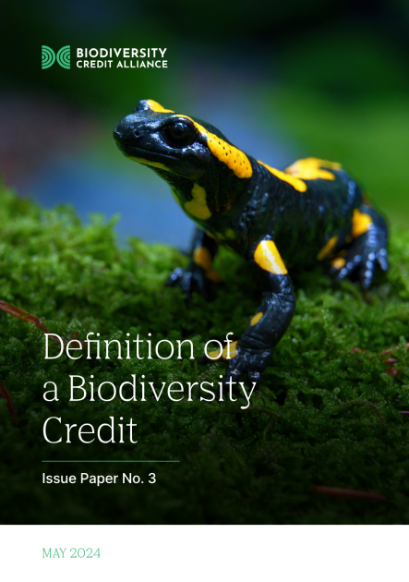
Businesses seeking credit market experience in anticipation of regulation
Voluntary footprint compensation driven by shareholder and stakeholder pressure
Businesses seeking to mitigate business risk emanating from nature dependencies
Financial institutions and markets seeking nature positive investments
Businesses seeking to comply with supra-national or national regulatory requirements
Government agencies or development banks implementing policies or regulations
Retail and individual consumer-facing companies and brands providing value for consumers
Philanthropists, including foundations

Slide 9
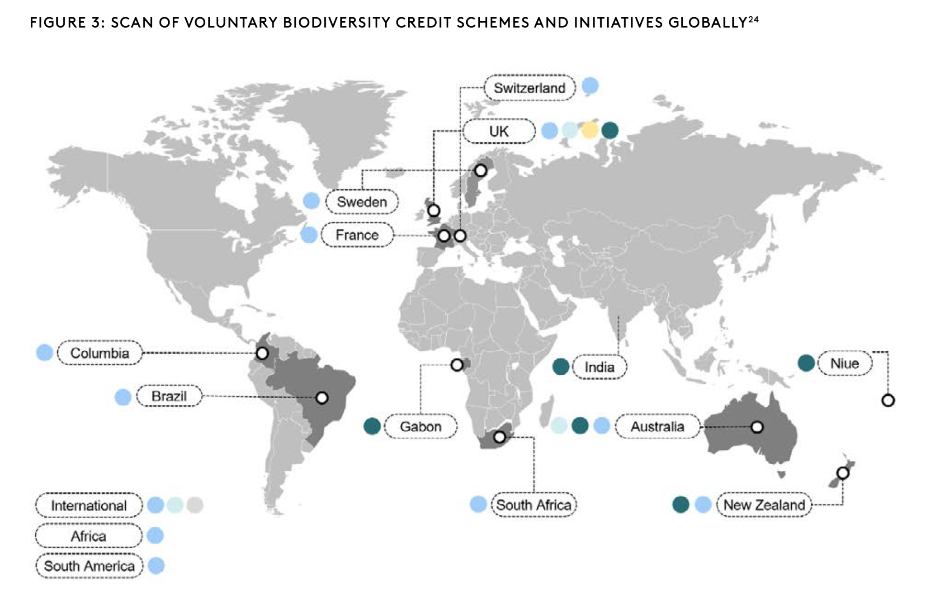
Private sector
Government-led
University-led
Independent standards
Pollination Group, Oct 2023
State of Voluntary Biodiversity Credit Markets: A Global Review of Biodiversity Credit Schemes

Slide 10
A biodiversity credit is a certificate that represents a measured and evidence-based unit of positive biodiversity outcome that is durable and additional to what would have otherwise occurred.

Slide 11
Biodiversity Credits Principles low-risk nature projects
Guarantees to achieve ecological performance based on any or all of the following:
1. Requirements for advance ecological performance before a significant portion of credits can be sold;
2. Significant insurance and bonding requirements on credit; or
3. Permanent/long-term endowments
Preference for restoration credits over preservation (i.e. avoided loss) credits
Government or other 3rd party verification before buyers can make claims around the uses of purchased credits.
Strong and multi-decadal or permanent land use restrictions
Multi-year monitoring plans funded and implemented by buyers, sellers, government or 3rd parties
A preference for sites that are more distant from impacted development sites
Compliance or enforcement policies through which a third party (including government) is responsible for confirming agreed upon actions, funding and environmental outcomes persist on at least a subset of audited projects.
Absence of government subsidy in the establishment of biodiversity credit sites that lowers the price of credits for buyers, other than when government itself is buying credits to meet its own needs.
Fiscal transfer must be held to the same or equivalent standards as environment banks
Notes:
Understanding Policy. England's new net biodiversity gain law goes into effect in November 2023. Established US endangered species banks as well as aquatic habitat banking programs have 20 years of experience that could help England's efforts improve faster. This report provides an overview of US audiences of England's new regulation, how its being implemented, and how it relates to lessons learned in some U.S. wildlife impact offset programs.
Accelerating project timelines. It takes over 1,000 days to approve habitat & species banks in the US. It’s not because of unreliable outcomes, but cumbersome permitting processes. We need to shrink these timelines. This report aims to provide a rigorous quantitative analysis of the most complete dataset available on the time it takes to approve mitigation bank instruments.
Better crediting tools. Technological advances are paving the way for more reliable and cost-effective measures of ecological uplift. Without high-quality outcomes to buy, biodiversity markets can’t be widely adopted. This blog discusses a real example of quantifiable ecological uplift using new technology and assessment criteria.
Strengthening demand in regulated systems. Since 1973, the US Endangered Species Act regulates what species need to be mitigated for, and how mitigation is determined. In this report, we offer ideas for improving species mitigation to address past gaps in practice and to confront future challenges arising from infrastructure development. The report then offers near- and longer-term recommendations to improve ESA mitigation that has direct applicability to new biodiversity efforts.

Slide 12
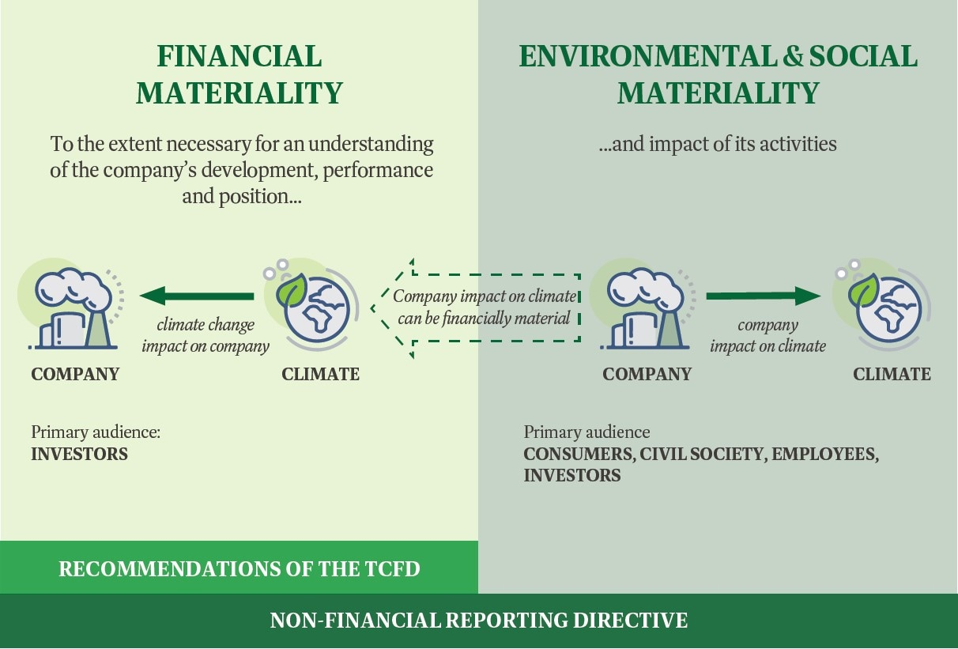
 | Impacts Avoidable | Impacts Unavoidable
Impact Materiality: the company impacts nature | TNFD somewhat relevant | TNFD of little value, biodiversity credits singularly useful (but only with regulatory rules inc. financial regs or public/shareholder pressure)
Double Materiality: Nature impacts financially affect company AND company impacts nature | TNFD at its best | Biodiversity credits somewhat relevant but on-site actions or ‘insetting’ more valuable
European Union’s Sustainable Finance Disclosure Regulation

Slide 13
Global Biodiversity Metric
Temperate forest & woodland criteria (example)
Species Composition
Structure
Disturbance
Proxy for biodiversity value
Metric components
Habitat size
Condition – habitat condition assessment criteria
Conservation priority – global tank status
Strategic significance – local priority/importance
Native plant species cover
Veteran trees
Tree health
Non-native invasive plant species cover
Vegetation structure
Herbivore damage
Native plant species composition
Regeneration
Anthropogenic Disturbance
Ground flora
Coarse woody debris
Good (3 pts)
Moderate (2 pts)
Poor (1 pt)
85-100% relative cover of native plant species across strata
60-84% relative cover of native plant species across strata
<60% relative cover of native plant species across strata
Notes:
User inputs include Size, condition, and strategic significance
Condition assessments based on a set of Habitat Assessment Criteria
Influenced by Ecological Integrity Assessment indicators developed by NatureServe
Generally, include Species, Structure, and Disturbance indicators
Example Temperate Forest and Woodland indicators
Set of 11 indicator
Each indicator is assigned a rating of Poor, Moderate, or Good as evaluated using a set of criteria
Natural disturbances difficult to account for especially over long return windows but ABM includes indicators to draw out the important role of natural disturbance

Slide 14
National registry
Registration of site as a credit bank
Easement
Offsite habitat restoration
Offsite bank owner
Responsible 3rd party
Credits
Monitoring fees for 30 years
Credit purchase agreement
Difference in units
Restoration on development site
Property developer
Application fees
Government agency that approves / denies
Credits
Approval of development

Slide 15
Requiring proof of ecological success BEFORE sale is allowed creates a requirement for private investment
Requirements for proof of ecological success need to be meaningful but also fast enough not to make economic return impossible (2-5 years?)
Bringing in requirements for specialized companies and for private investment brings two powerful new advocates to lobby for markets and rules
Programs, including government review or permission, need to be transactional and efficient so it is easier to comply than fight
Nature restoration is a specialized field and nature-focused businesses are going to do it better
Non-profits don’t adjust well to competition from the private sector and government often works with them to block for profit initiatives
Government competes with the private sector and often captures funding, but at a money-losing rate and delays, putting their efforts into a lose-lose downward spiral
Conservative political parties and business leaders are often the champions and successful actors in these programs
‘Offsetting’ has to be seen as positive as it is the only way to allowing intrinsically damaging economic activity to have a way forward

Slide 16
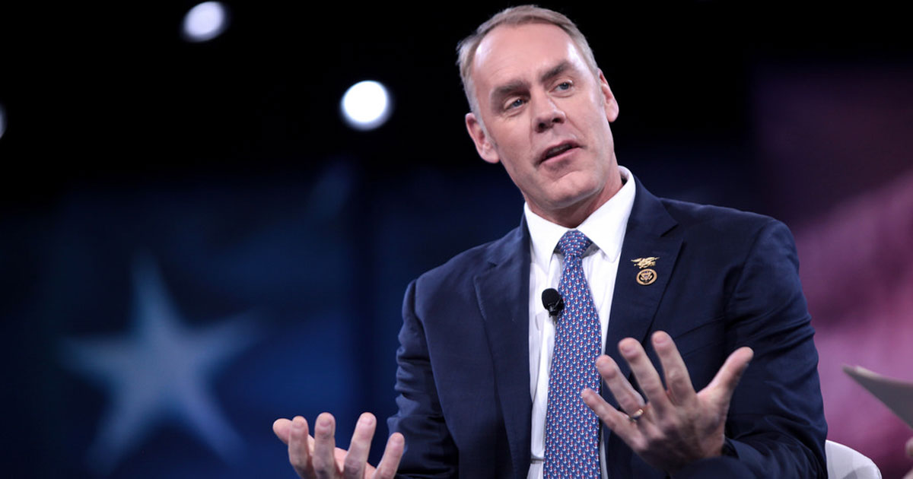
Environmental mitigation: “Some people will call it extortion. I call it un-American.”
- President’s Trump’s first secretary of natural
resources

Slide 17
Withdrawal from Paris Accord
Rescinds most past climate-related executive orders
Rescinds the executive order on the disclosure of climate risks
Ends the US ‘Climate Corps’ youth jobs program
“Policy-influencing career bureaucrats can be terminated for not “faithfully implementing” White House policy, priorities, and initiatives
Eliminates protections for old growth forests and national forest restoration goal
Directs new guidance on implementation of our environmental impacts law and directs agency to propose rescinding all the environmental impact law regulations
Temporary halt to all foreign aid
Rescinded order that directed White House budget office to develop ecosystem services guidance (previously the highest level document covering ecosystem service markets)
Eliminated direction on nature-based solutions
End US participation in climate finance plan
Directs the use of emergency procedures for most permitting affecting anything to do with energy production and distribution
Makes it US policy to become the leading producer of non-fuel minerals including rare earth minerals and directs a review of all regulatory or procedural burdens that impact that goal.
Halts all funding for green initiatives under the Inflation Reduction Act.

