Slide 1
GLOBAL BIOCREDIT STANDARD
World Forest Forum Event 2025-01-22
Aleksandra Holmlund

Slide 2
01
01
Section 01
EXECUTIVE SUMMARY

Slide 3
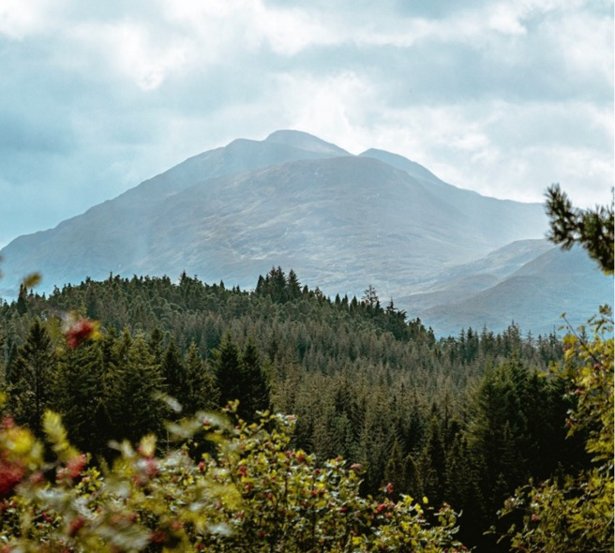
GLOBAL BIODIVERSITY CREDIT STANDARD
The preferred biodiversity credit standard for production landscapes
WHY: Sustainable production combined with nature preservation
Combining nature preservation with production for a growing population will be the defining challenge for humanity in the 21st century and presents a huge business opportunity with the total estimated market potential of around USD 70 billion by 2050¹
WHAT: The Global Biocredit Standard:
There is a need for a simple, easy to use standard for biodiversity credits which can be applied to the reality of existing production landscapes world-wide, allowing market-based compensation of land owners for nature conservation efforts
The Global Biocredit Standard is the only standard in the world that specifically addresses nature conservation in production landscapes such as forestry and agriculture, where we grow our food and wood products
HOW: Standard setting organisation:
The Standard needs to be hosted by a legal entity, a Social Enterprise, which will administer and further develop the Standard. The enterprise will further invest 50%-100% of its profits to biodiversity research and initiatives that contribute to nature conservation
1) McKinsey report:
Biodiversity Credits: Demand Analysis and Market Outlook (https://www3.weforum.org/docs/WEF_2023_Biodiversity_Credits_Demand_Analysis_and_Market_Outlook.pdf)

Slide 4
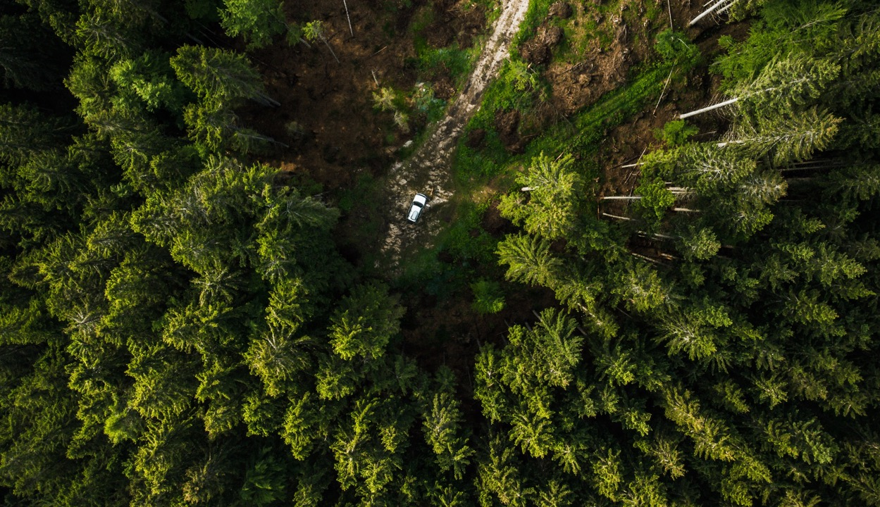
02
01
Section 02
THE NEED FOR BIODIVERSITY CREDIT STANDARD FOR PRODUCTION LANDSCAPES

Slide 5
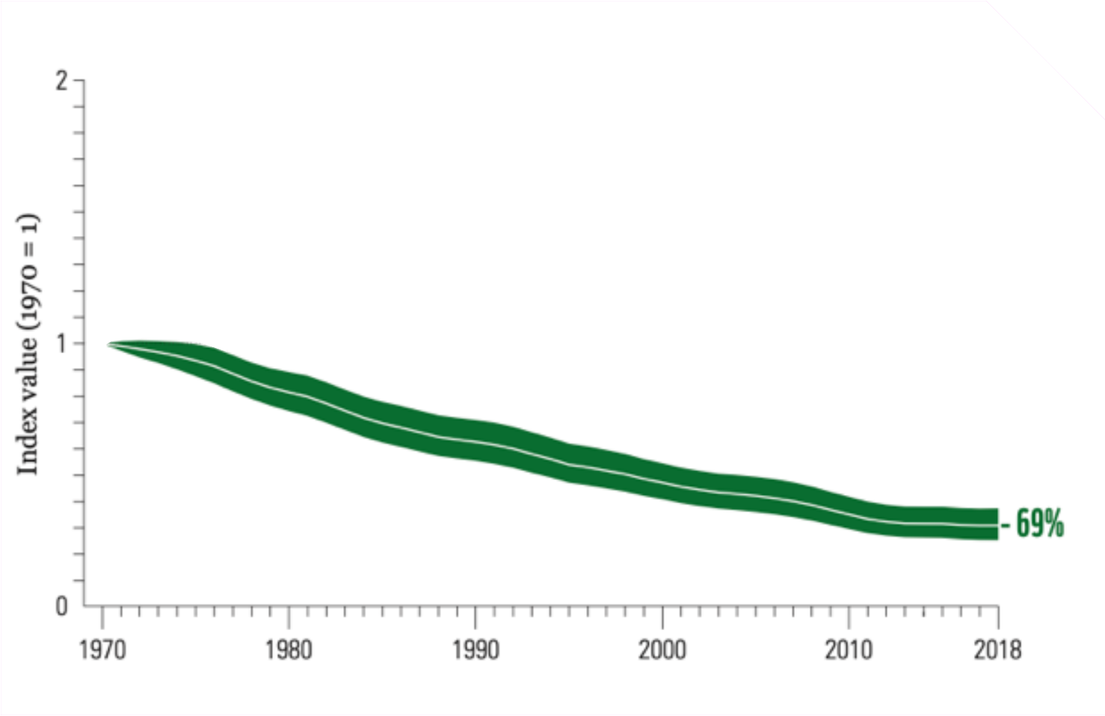
THE BIODIVERSITY CHALLENGE
The global Living Planet Index (1970 to 2018)¹
A vital but overlooked aspect for the survival of humanity
Biodiversity loss, together with climate change, is an urgent and existential threat to life on earth
Nature is experiencing a rapid decline across multiple areas. Wildlife populations have decreased by 69% in since 1970 and the rate of species extinction is now 1,000 times greater than in prehistoric times
Around 90% of biodiversity loss is attributable to agriculture and forestry practices
Combining nature preservation with production for a growing population will be the defining challenge for humanity in the 21st century
Awareness of biodiversity loss is growing – but the necessary knowledge, tools and funding to address it is often lacking or inadequate
Innovative new solutions will be needed to tackle this monumental challenge
Biodiversity loss harming forest productivity
There is strong evidence linking biodiversity to forest productivity
On average, a 10% loss in biodiversity leads to a 3% loss in productivity²
Note: 1) The average change in relative abundance of 31.821 populations, representing 5,230 species monitored across the globe, was a decline of 69%. The white line shows the index values, and the shaded areas represent the statistical certainty surrounding the trend (95% statistical certainty, range 63% to 75%). Source: WWF/ZSL (2022). 2) Liang et al, Science, 14 October 2016

Slide 6
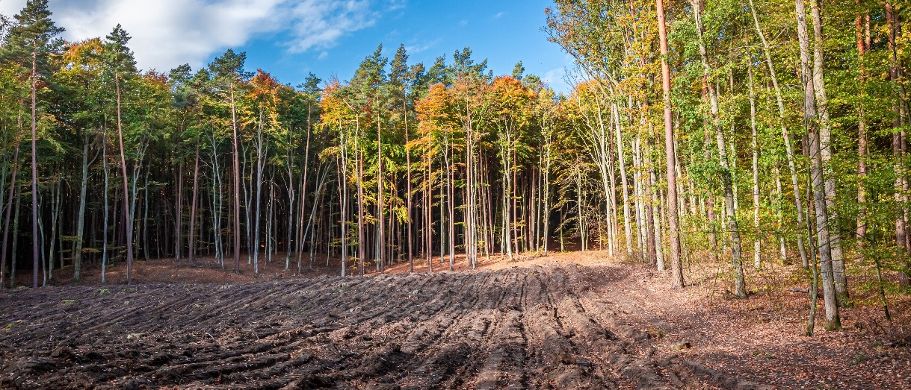
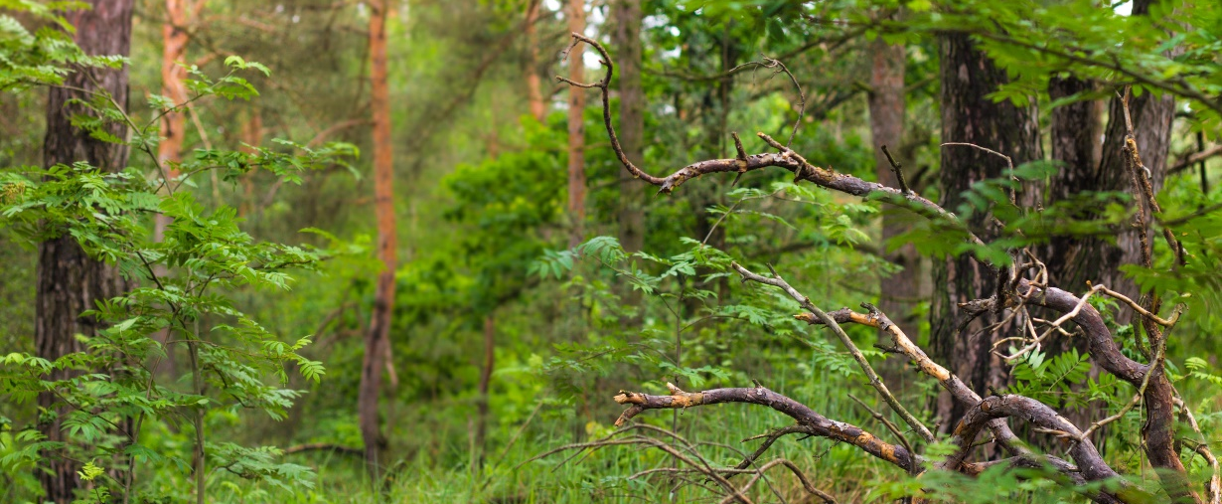
FINDING new solutions
Combining biodiversity improvement with sustainable production will be key to success
To halt and reverse global biodiversity loss, a multitude of solutions will be needed
The preservation of remaining wild habitats is crucial – but not enough
A majority of the world’s habitable land is made up of production landscapes (agriculture and forestry)¹: increasing biodiversity in production landscapes is therefore key for biodiversity overall
Swedish Biocredit Alliance² has developed the world’s first Global Biocredit Standard for production landscapes – and executed first transactions in forest projects
The standard is unique globally because it specifically addresses production landscapes in a practical and pragmatic way
Other existing standards, such as Verra or Plan Vivo, either prohibit the use of monocultures or are unnecessarily complicated and costly to use to be truly scalable
Allowing continued sustainable production….
By financing nature protection and restoration in combination with production…..
Notes:
1) Out of 10.7bn ha of habitable land on Earth, c. 4.8bn ha is used for agriculture production and 1.2bn ha for forest production. Source: Our Would in Data (Oxford University et al.),
2) Swedish Biocredit Alliance was previously run as a project to create a market for biodiversity credits

Slide 7
WHY DO WE NEED ANOTHER STANDARD?
Other biodiversity credit standards exist, notably:
Verra’s SD Vista
Plan Vivo
Others: Savimbo, Terrasos, and other smaller standards
However, these standards:
Sometimes prohibit monocultures and exotic species in biodiversity credit projects, which are often used in agriculture and forestry
Are very complex to implement
Sometimes require actual uplift in biodiversity before payments can be issued, which is hard to predict and requires projects to find large upfront financing
There is a need for a simple, easy to use standard which can be applied to the reality of existing production landscapes world-wide.
This is important because businesses and financial institutions have already invested a lot in production landscapes and there is a need to safeguard those investments in terms of future climate and nature resilience and risk.
By connecting biodiversity credits to where businesses’ value chains are making impact, we are creating an opportunity for market-based financing of nature conservation.

Slide 8
03
01
Section 03
THE GLOBAL BIODIVERSITY CREDIT STANDARD FOR PRODUCTION LANDSCAPES

Slide 9
SWEDISH BIOCREDIT ALLIANCE (SBA)
Applying global recommendations to practical applications
As a result of research on biodiversity credits at the Swedish University of Agricuture, a privately financed project “Swedish Biocredit Alliance” was launched in 2023
Its purpose was to condense existing recommendations on biodiversity credits from the Biodiversity Credit Alliance (BCA) and International Advisory Panel on Biodiversity (IAPB), test practical implementations on pilot projects and recommend a standard for biodiversity credits in production landscapes which can be applied globally
The project was financed by World Forest Forum (WFF), Qarlbo Biodiversity, Södra Skogsägarna, Norra Skog and Umeå Municipality, who all participated as working Task Force Members in the project. In summary, the project represented over 50 000 private forest owners, a non-profit organisation, an investor, a verification and validation organisation, and a municipality, showing a very broad support for the project and a bottom-up approach of including a variety of stakeholders.
Additionally, there were further consultations with other NGOs such as WWF, different research groups and businesses as potential buyers of biodiversity credits.
THE NATURE+ TEAM

Slide 10
THE STANDARD
Globally applicable to production landscapes
In October 2024, SBA launched The Global Biocredit Standard for Production Landscapes
The Standard was presented at the COP16 in Cali, Colombia
It is the only standard in the world that specifically addresses production landscapes
The Standard is public and can be downloaded at https://swedishbiocreditalliance.se/wp-content/uploads/2024/10/The-Global-Biocredit-Standard-final.pdf
A standard can hold many verified methodologies – for example Qarlbo Biocredit Methodology for Production Forests

Slide 11
FROM STANDARD – TO STANDARD-SETTING ORGANISATION
Implementing good ideas
A standard cannot live on its own. For it to be practically implemented there must be a standard-setting organisation in place.
A standard-setting organisation:
Administers, further develops the standard and keeps it up-to-date with global developments
Provides advice to methodology and project developers
Organizes independent methodology and project reviews and recommends third party auditors
Keeps registry of approved methodologies and projects
Issues and retires credits
Provides information on latest recommendations on biodiversity credits to market participants
Therefore, we propose that this standard is given a permanent home in The Global Biodiversity Credit Standard for Production Landscapes, in form of a Social Enterprise, presented in the following pages
AN INVESTMENT THAT PROMISE RETURNS – AND RETURNS

Slide 12
ORGANISATION
Professionalism and integrity
The organisation will initially consist of a CEO, a project manager (and a marketing manager)
Around year 4, and depending on how well the business of the standard is developing, the idea is to employ about 2-4 more people, for example a technical specialist and another project manager.
CEO
Project Manager
Marketing Manager
Project Manager
Technical Specialist
Employed during year 1
Employed around year 2-4
THE NATURE+ TEAM

